Slide 1


AP BIO
TOPIC 8.2:
Energy Flow Through Ecosystems

Slide 2
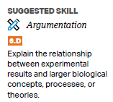
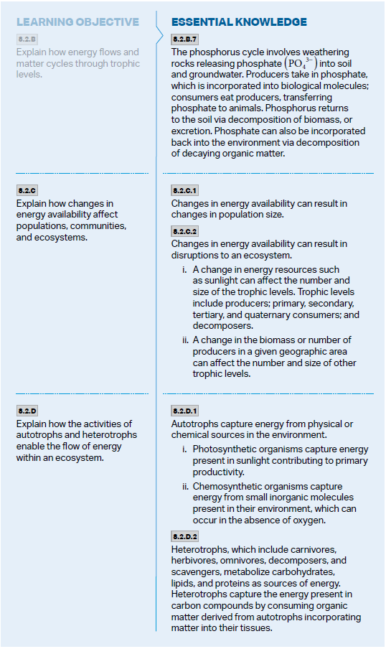
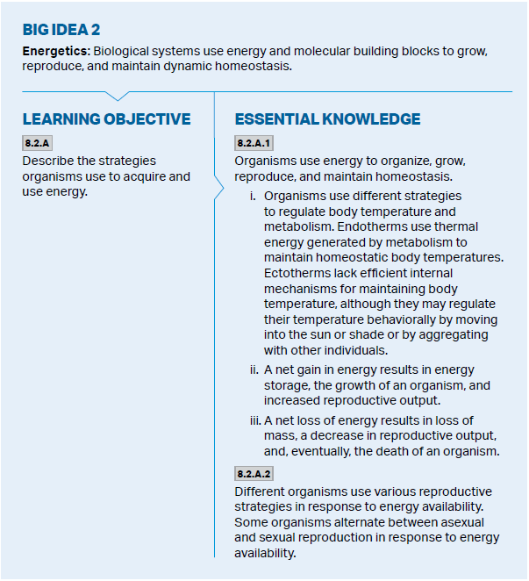
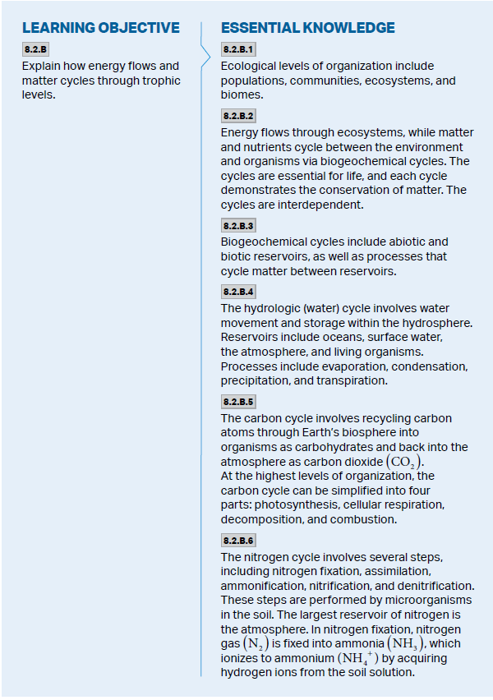
Objectives

Slide 3
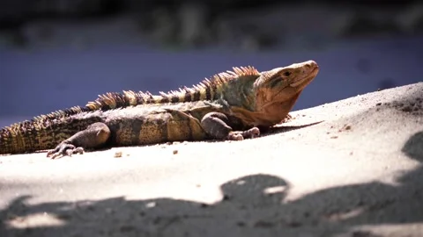
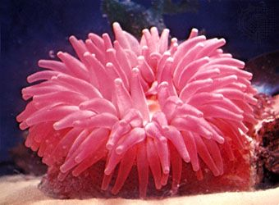
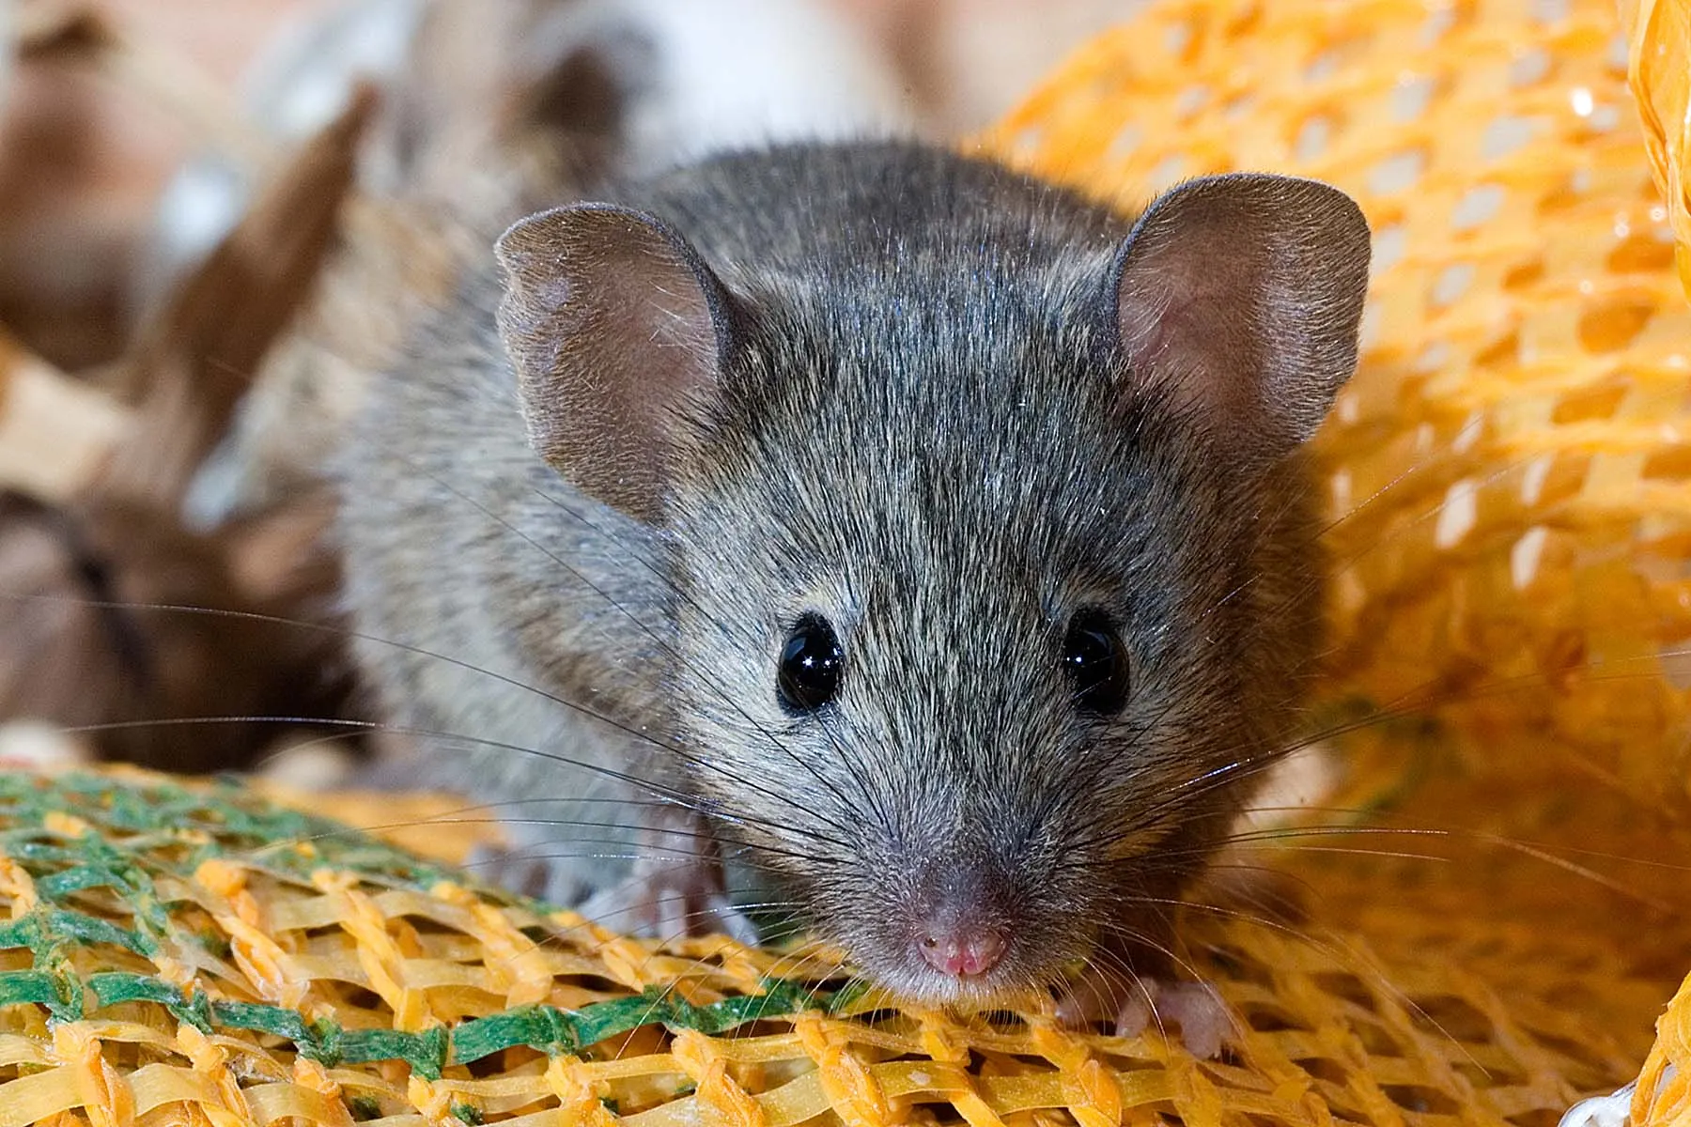
Organisms Need Energy
To organize, grow, reproduce, maintain homeostasis – maintain a stable internal environment despite external changes
Thermoregulation – how animals maintain internal temperature
Endotherms – warmed by heat generated through metabolism – all chemical reactions of the body
Ectotherms – get heat from external sources
Net gain in energy = storage, growth, reproduction
Reproductive strategy can be different based on energy available – asexual/sexual, reproductive diapause
Net loss in energy = less reproduction, death
Metabolic rate – total energy used, smaller animals have higher

Slide 4
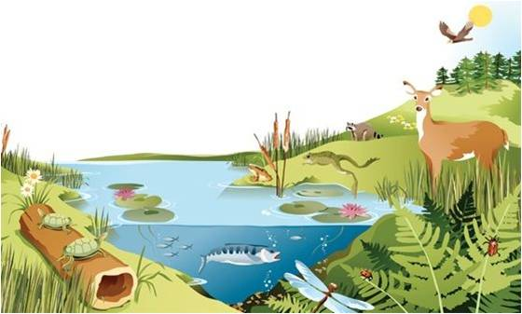
Energy Flows and Matter Cycles
Populations -> Communities -> Ecosystems -> Biomes
Energy flows through ecosystems (both biotic and abiotic factors) between organisms – sourced from the sun
Matter and nutrients are cycled (biogeochemical cycles)
Contain abiotic and biotic reservoirs, and processes that cycle matter between reservoirs
Law of Conservation of Mass, Law of Conservation of Energy – cannot be created or destroyed, only transferred from one form to another

Slide 5
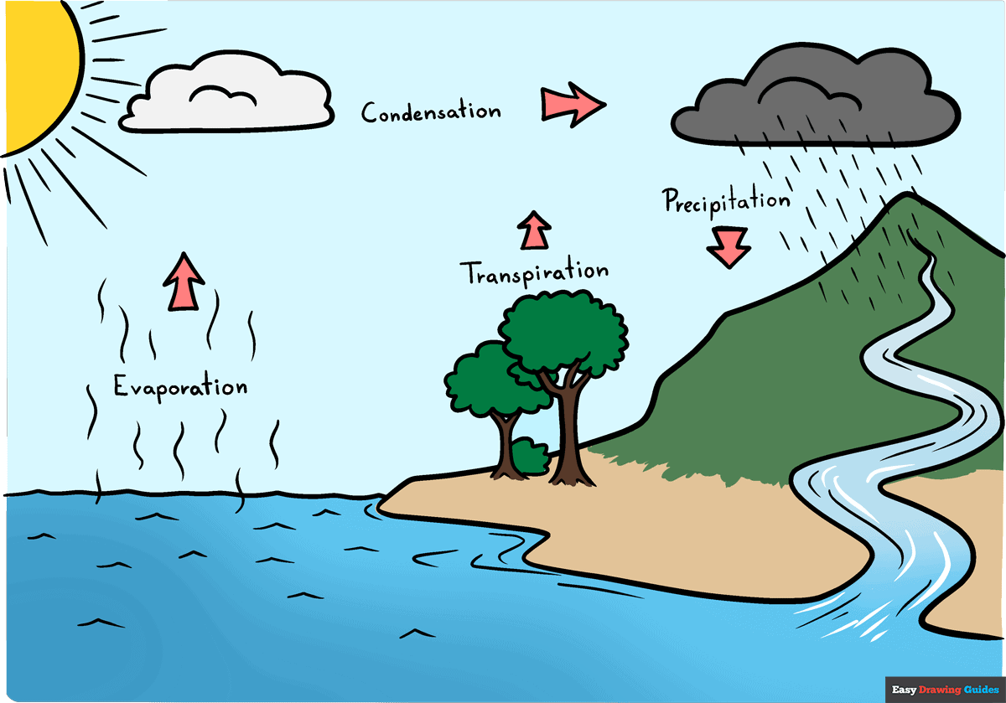
Biogeochemical Cycles: Water
Hydrosphere – encompasses all water on Earth
Water evaporates from oceans and surface water, and transpires from plants -> condenses in atmosphere -> precipitates back to sources of water
Organisms intake water for survival and excrete it
Water
Hydrosphere
Oceans, surface water, atmosphere, organisms
Evaporation, Condensation, Precipitation, Transpiration

Slide 6
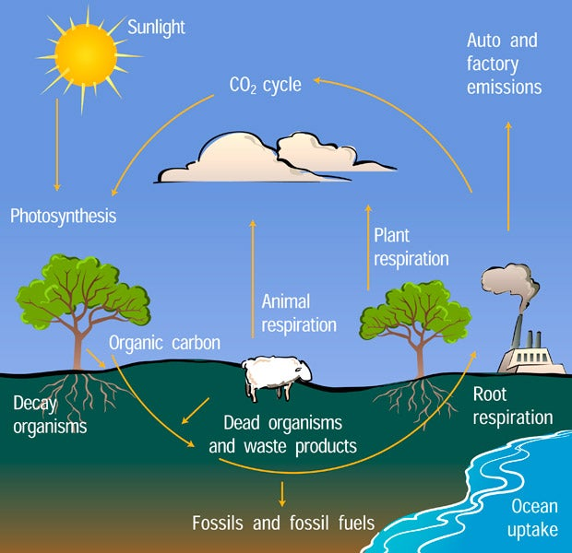
Biogeochemical Cycles: Carbon
Carbon
Biosphere, Atmosphere
Carbohydrates in organisms, CO₂ in atmosphere
Photosynthesis, Cellular Respiration, Decomposition, Combustion
Transferred between atmosphere and biosphere – life between organisms (carbohydrates) and the atmosphere (carbon dioxide)
Turned into carbs by photosynthesis, released into atmosphere through cellular respiration, decomposition – dead organic matter broken down, releasing nutrients into environment, combustion – substance reacts with an oxidant, producing heat and light

Slide 7
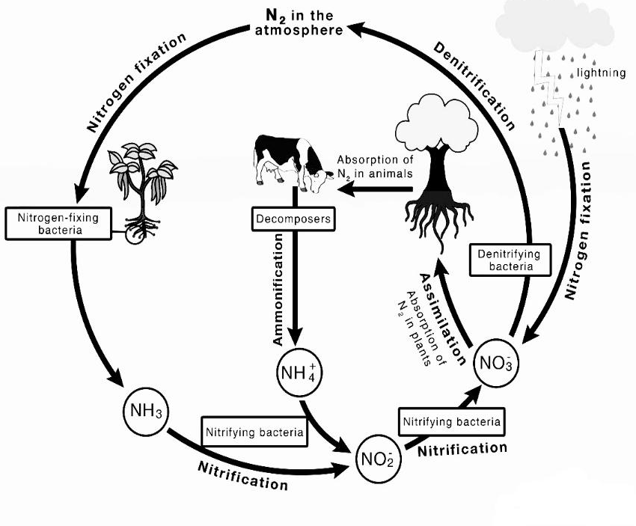
Biogeochemical Cycles: Nitrogen
Nitrogen
Biosphere, Atmosphere
Most in atmosphere, when fixed N₂ becomes NO₃- and NH₃ by microorganisms in soil
Fixation, assimilation, ammonification, nitrification, denitrification
Largest reservoir is atmosphere
Certain bacteria in soil fix nitrogen gas (fixation) N₂ -> NH₃ – ammonia, becomes ammonium through soil (NH₄+)
Ammonia also converted to nitrates (nitrification)
Plants get nutrients and bacteria get compounds from the plant (assimilation)
When organisms die ammonia is released into soil (ammonification) and nitrates converted back to gas (denitrification) by bacteria

Slide 8
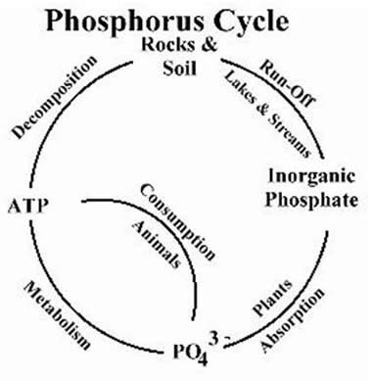
Biogeochemical Cycles: Phosphorus
Weathering rocks release phosphate (PO₄³-) into soil and groundwater
Taken up by plants -> transferred to animals
Returns to the soil through decomposition and excretion
Phosphorus
Biosphere, Hydrosphere, Lithosphere
Rocks, soil and groundwater, plants, animals
Weathering, consumption, decomposition, excretion

Slide 9
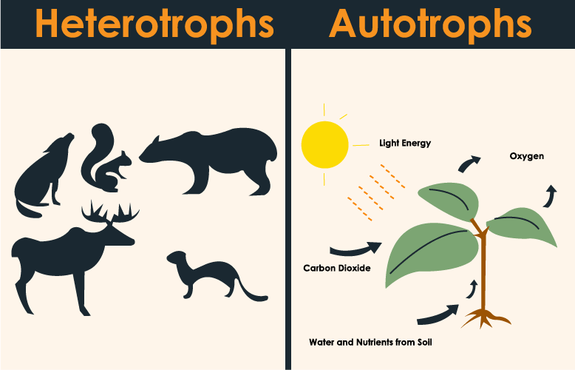
Autotrophs vs. Heterotrophs
Autotrophs (producers) – capture energy from environment
Photosynthetic – energy captured from the sun (plants, algae)
Chemosynthetic – energy from inorganic molecules, in the absence of oxygen, sunlight
Heterotrophs (consumers) – capture energy in carbon compounds by consuming energy from organic matter in autotrophs
Metabolize carbohydrates, proteins, lipids for energy
Herbivores, omnivores, carnivores, decomposers, scavengers

Slide 10
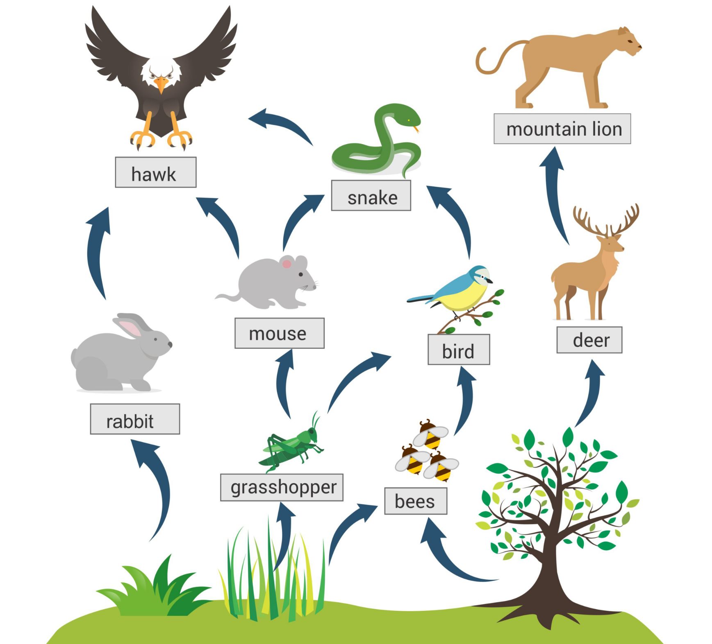
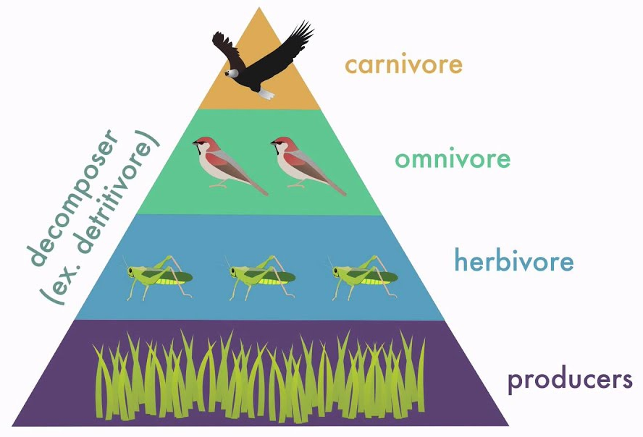
Trophic Levels and Changes in Energy
Energy flows through trophic levels (levels in a food web) from producers to primary, secondary, and tertiary consumers
10% rule – rest lost as heat
A change in the number of producers and sunlight can affect the rest of the trophic levels
Food web – shows energy relationships between organisms in an ecosystem

Slide 11
Energy Flow Through Ecosystems Review
Thermoregulation
Energy flow
Biogeochemical cycles
Trophic levels
Autotrophs vs. Heterotrophs

